Slide 1
D E P A R T M E N T O F C O M P U T E R S C I E N C E U N I V E R S I T Y O F C O P E N H A G E N
Tracking II: Visual 3D human motion tracking
Kim Steenstrup Pedersen
Notes:
<number>

Slide 2
Plan for today
Visual human motion tracking:
Marker-based versus marker-less tracking
Articulated visual 3D tracking

Slide 3
3D human motion tracking
Def.: Estimation of 3D pose and motion of an articulated model of the human body from visual data – this is referred to as motion capture.
Marker-based motion capture (MoCap):
Outcome: Tracking markers on joints in 3D giving joint positions.
Markers: Acoustic, inertial, LED, magnetic, reflective, etc.
Cameras or active sensors.
Marker-less motion capture (MoCap):
Outcome: 3D joint positions or triangulated surfaces and relation to video sequence.
Multi-view (several cameras / views)
Monocular (single camera / view)
Camera / view types: Optical camera, stereo pair, time-of-flight cameras, etc.
Notes:
Also known as “motion capture”
Marker-based used by Hollywood.
Today I will focus only on 3D marker-less visual tracking.
<number>

Slide 4
Marker based motion capture: System from Vicon (www.vicon.com)
http://www.youtube.com/watch?v=2uDnW4AtFiE&feature=player_embedded

Slide 5
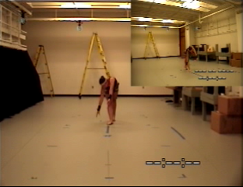
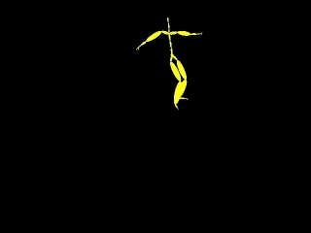
Marker based motion capture
[http://mocap.cs.cmu.edu/]
Notes:
Notice that she wears markers strategically placed on her body.
The two videos are not synchronized.
<number>

Slide 6
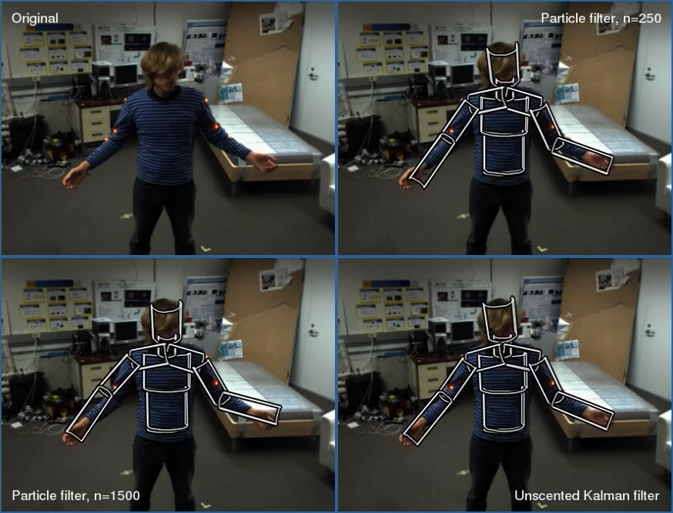
Marker-less motion capture: Using a stereo camera (Markers for ground truth – NOT for tracking)
Notes:
Less precise
<number>

Slide 7
Why do we want to do tracking of human motion?
Human computer interaction: Non-invasive interface technology
Computer animation: Entertainment (movies and games), education, visualization
Human motion analysis:
Surveillance: Suspicious behavior recognition, movement patterns
Biomechanical modeling
Physiotherapeutic analysis: Sports performance enhancement, patient treatment enhancement
Notes:
Biomechanical modeling: As a measurement tool. Collect empirical evidence useful in improving human motion models.
<number>

Slide 8
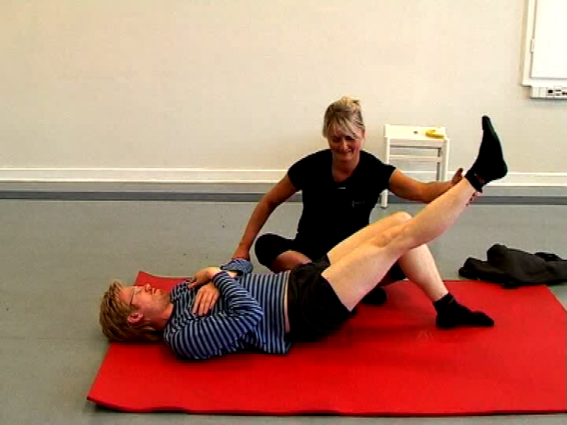
Interactive physiotherapy: Interactive training with feedback at home

Slide 9
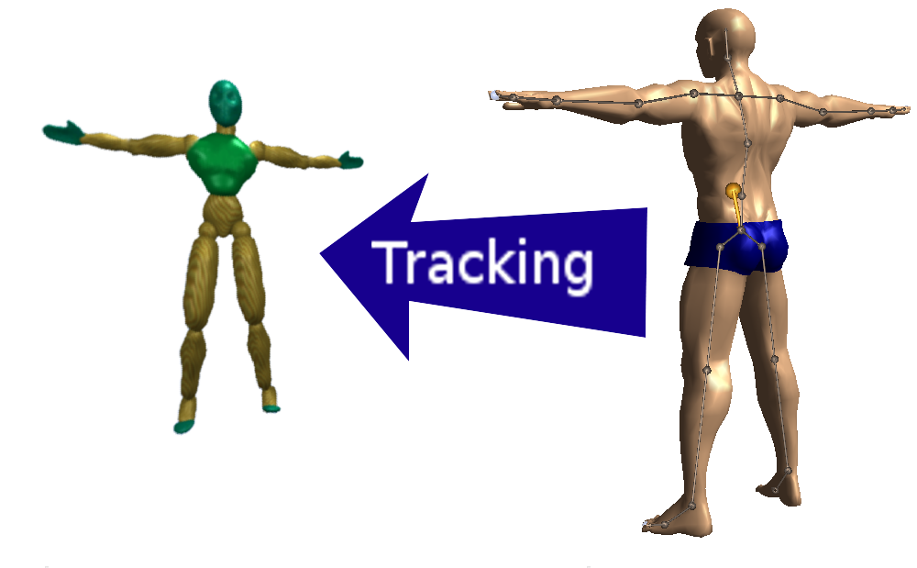
Vision for interactive physiotherapy: Measurements

Slide 10
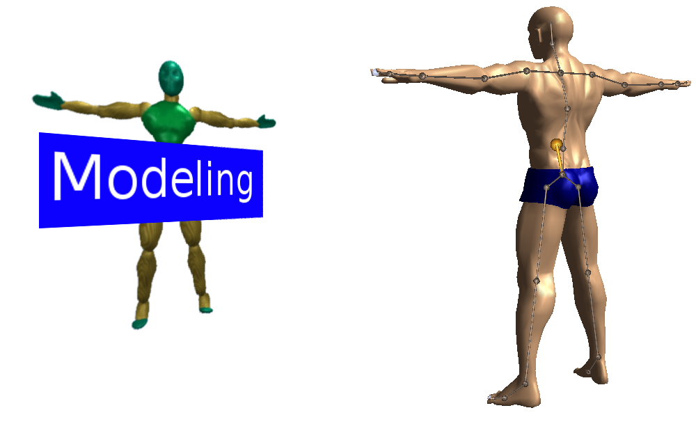
Vision for interactive physiotherapy: Modeling of exercise

Slide 11
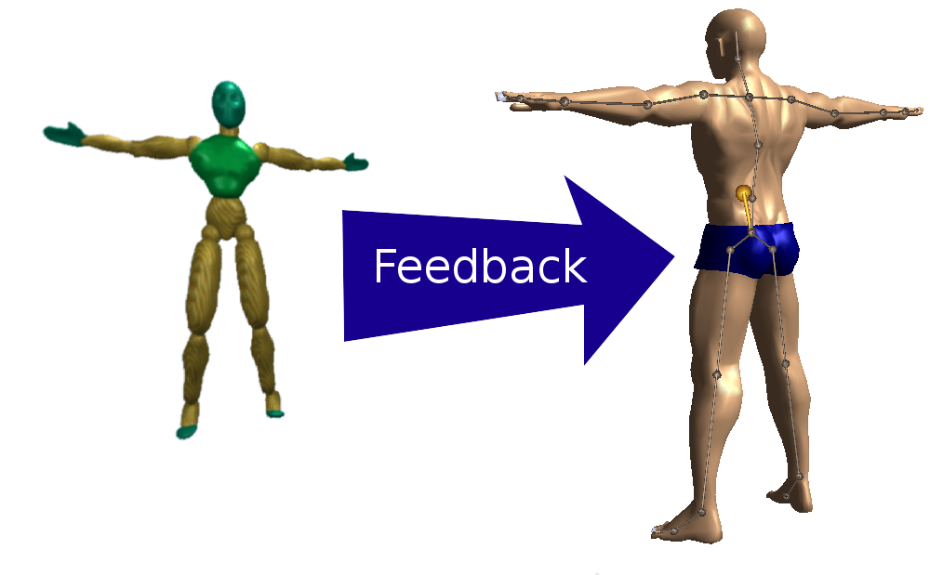
Vision for interactive physiotherapy: Feedback (“lift your arms higher”)

Slide 12
Demo
Notes:
<number>

Slide 13
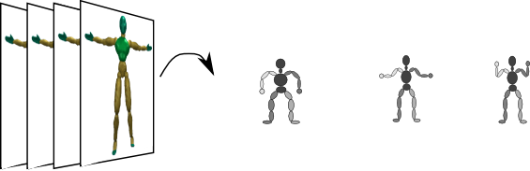
This is what we want to do (Tracking = seq. estimation of pose from observations)
Video sequence
Sequence of estimated poses
Notes:
The video sequences can be from one or more cameras / views
<number>

Slide 14
Approaches to visual marker-less tracking
Model-based tracking
Introduce a model of the human body and estimate pose by estimating model parameters from observations.
Downsides: Relation between model and observation is important. Often these methods require re-initialization.
Model-free tracking
Learning-based approach: Learn a direct map from observations to pose (e.g. a classifier)
Examplar-based approach: Infer pose by matching observations to examplar poses.
Downsides: Requires lots of training examples to either learn or construct examplar database.
Notes:
I will mainly talk about model-based approaches today
<number>

Slide 15
Observations / Measurements
Types of observations:
Features
Texture / regions descriptors
Silhouette
3D reconstruction / depth data (stereo, time-of-flight, active stereo (e.g. MS Kinect)).
Notes:
As in other parts of computer vision we want to reduce information. Using the raw pixels is too much and noisy.
<number>

